Slide 1
global ammonia emissions
Zhenqi Luo 2021.1
Notes:
https://doi.org/10.5194/acp-20-2277-2020

Slide 2
progress
1. filter (cloud coverage < 10%, skin temperature > 263.15K) the IASI daily datasets by keeping negative values
2. IASI emission fluxes versus GEOS-Chem emission inventory
3. Spatial distribution of mean and trend
4. regional annual and monthly mean concentration

Slide 3
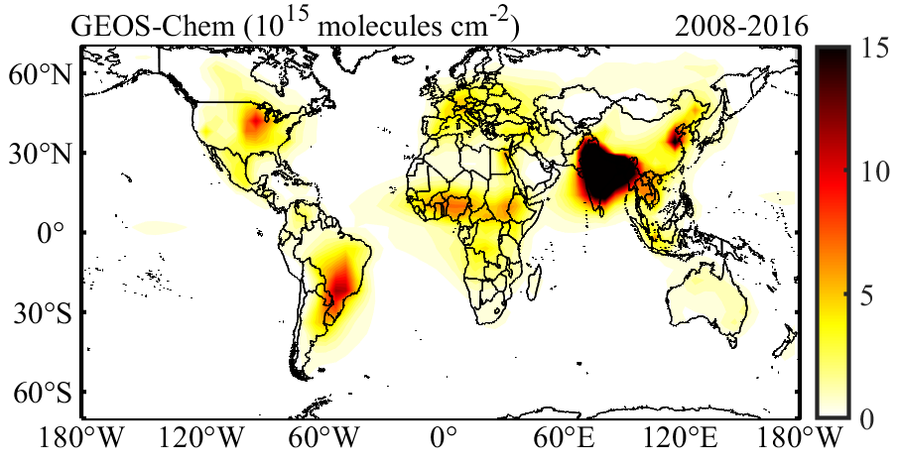
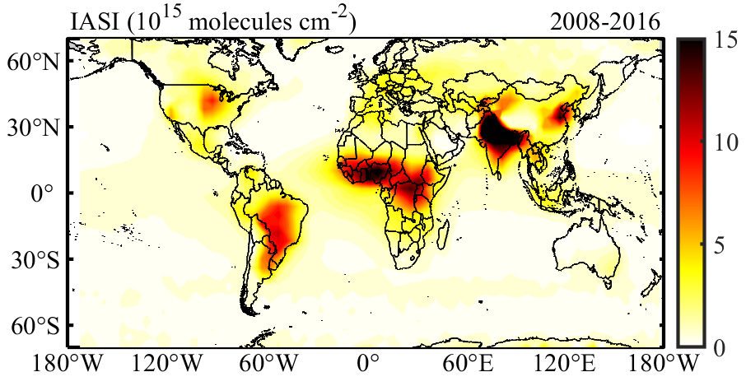
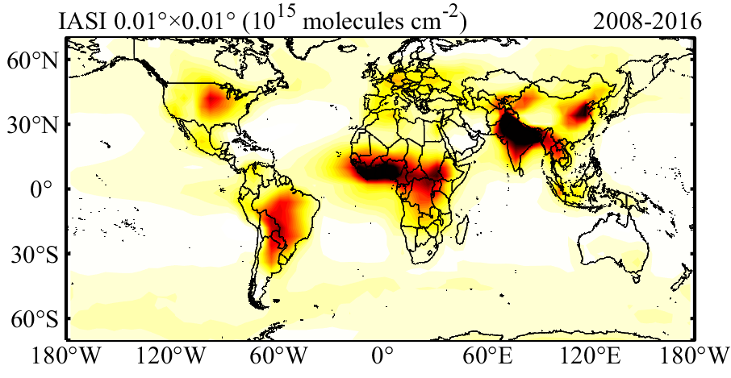
Keep negative of IASI
biases: IASI is a little higher than GEOS-Chem
Africa
Russia
Ocean background

Slide 4

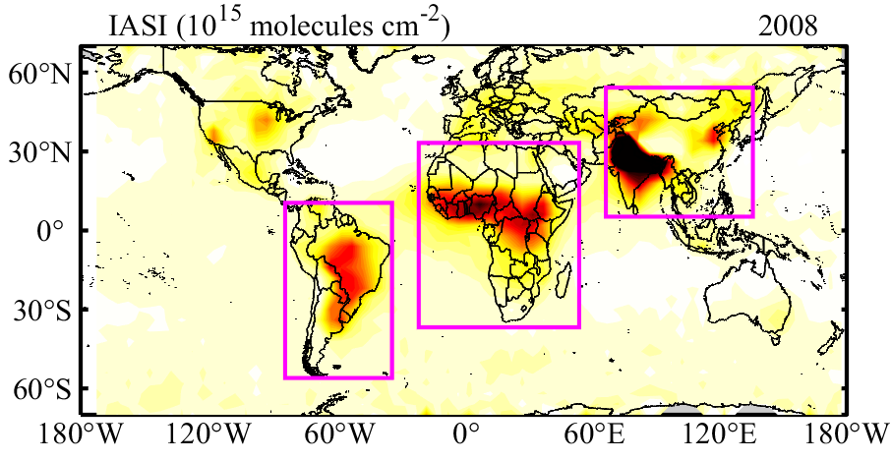
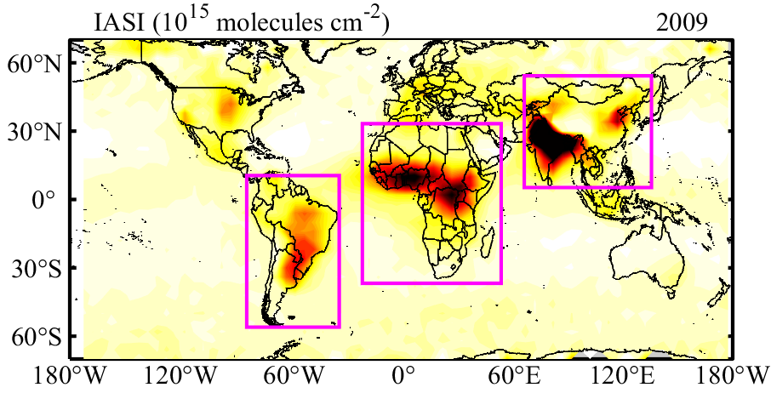
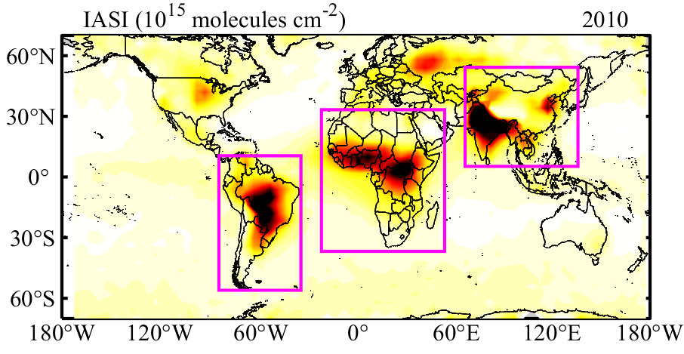
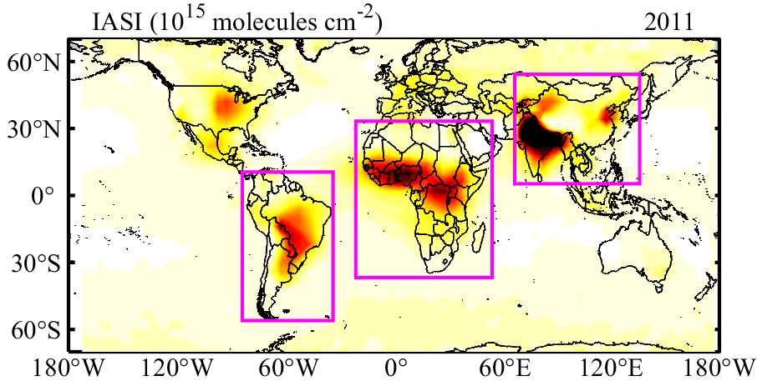
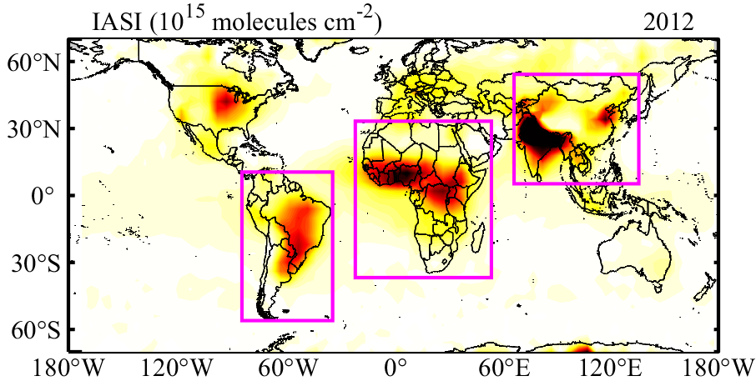
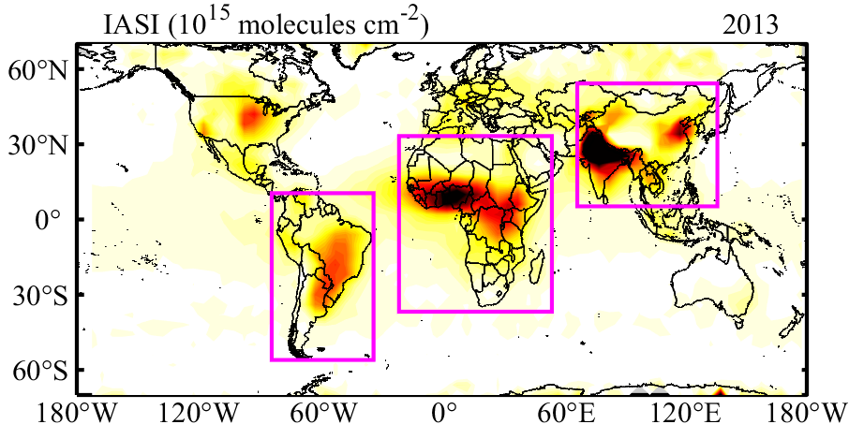
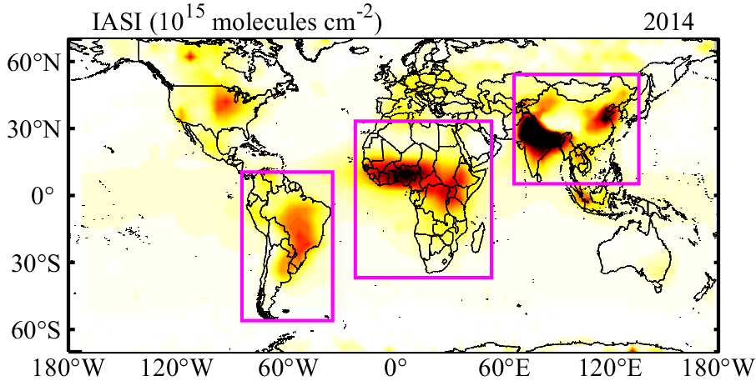
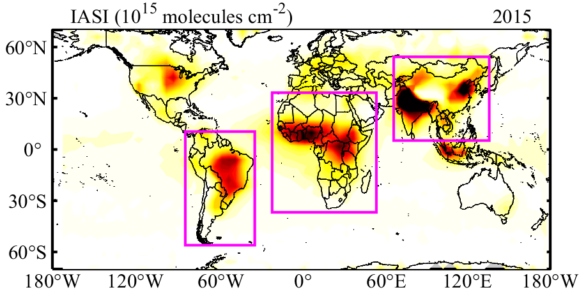
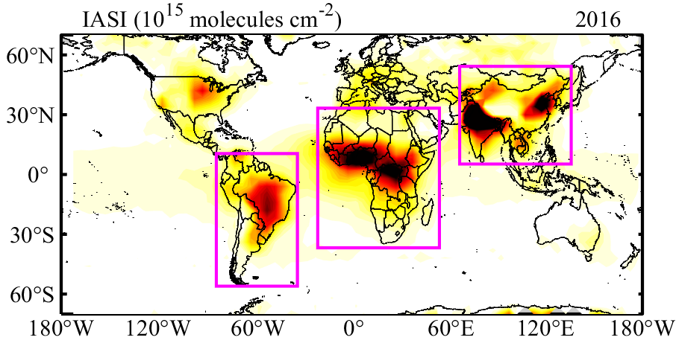
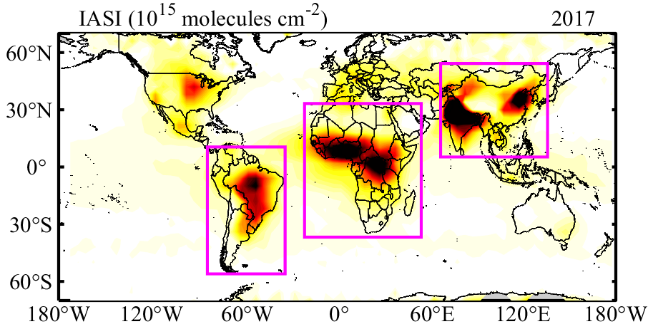
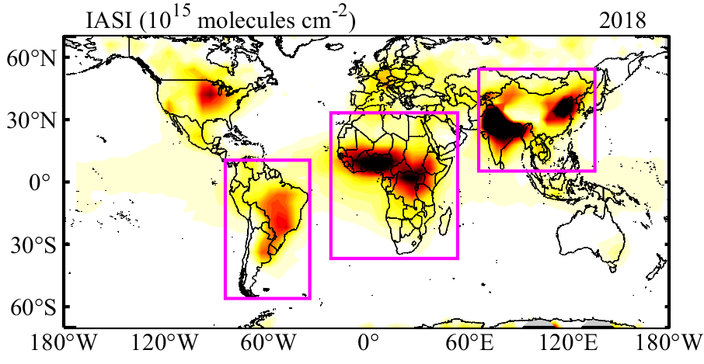
IASI mean in annual concentration distribution

Slide 5
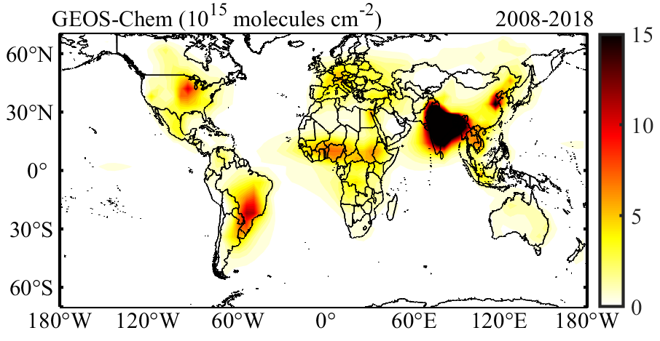
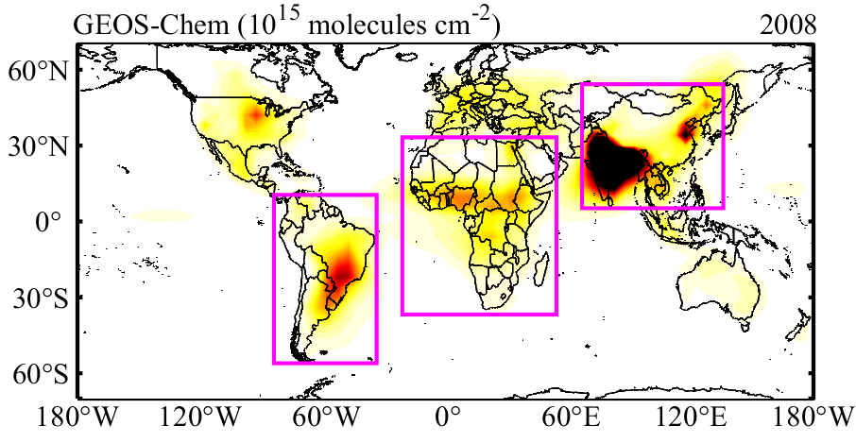
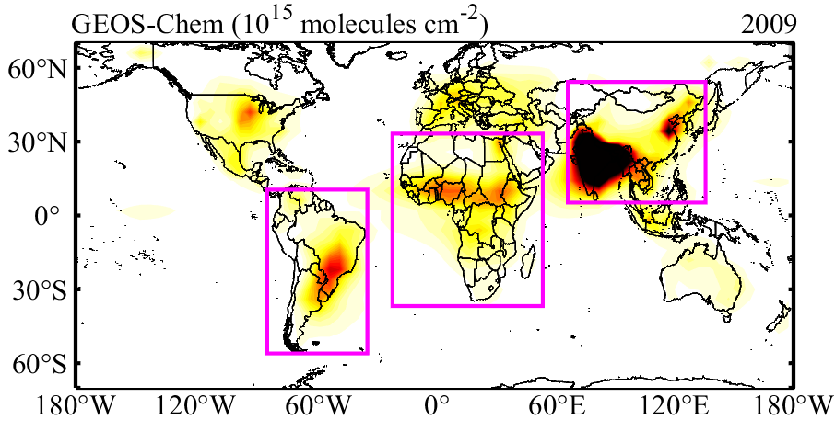
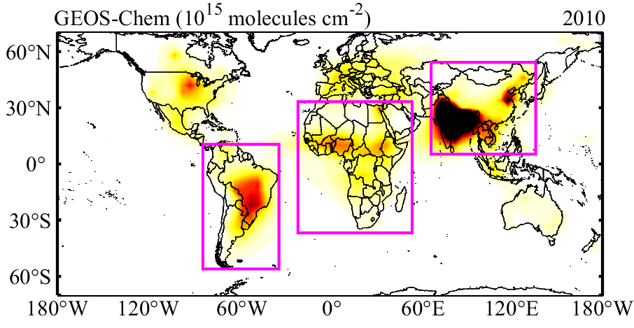

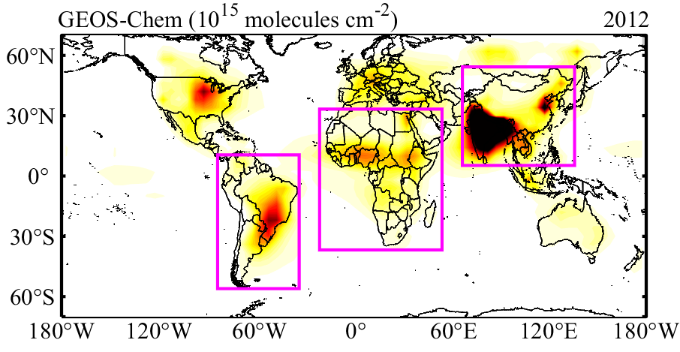

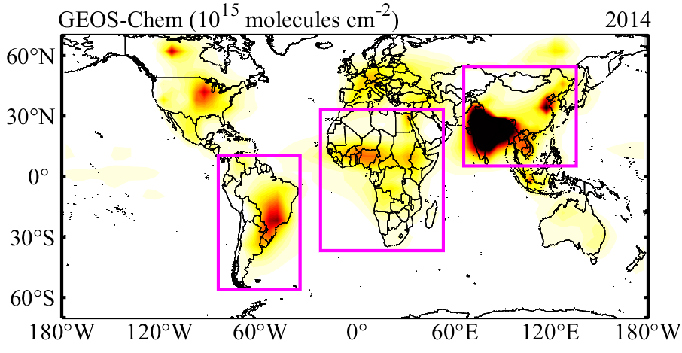
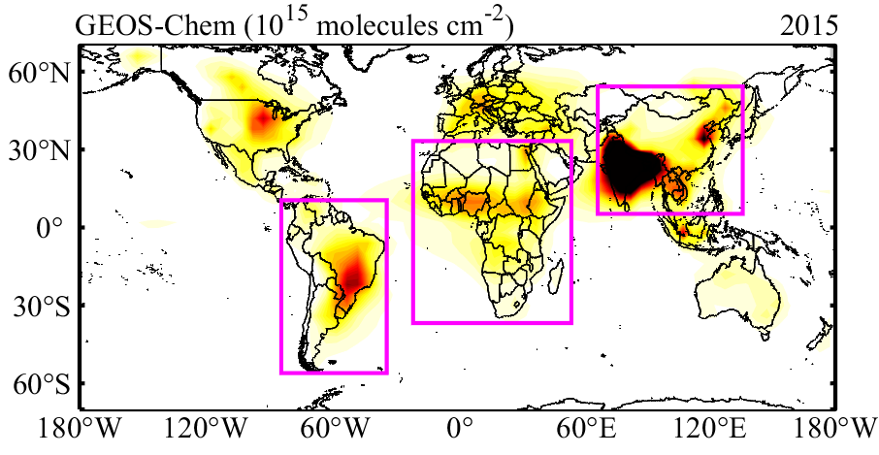
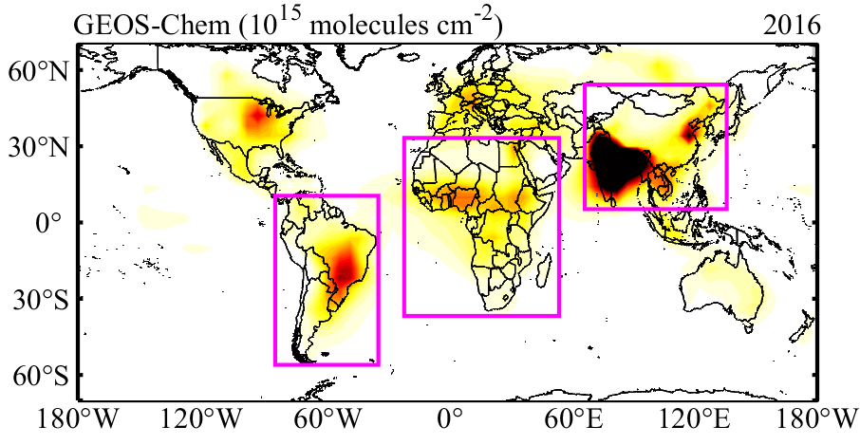
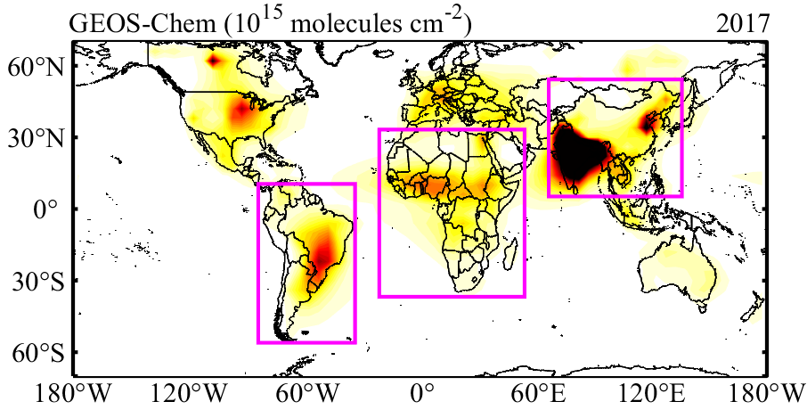

GEOS-Chem mean in annual concentration distribution

Slide 6
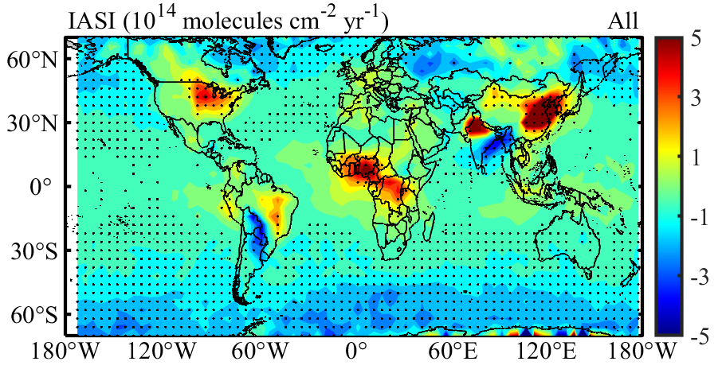
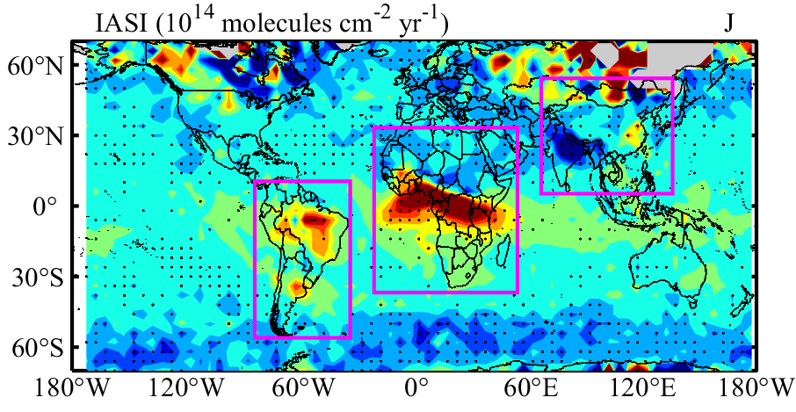
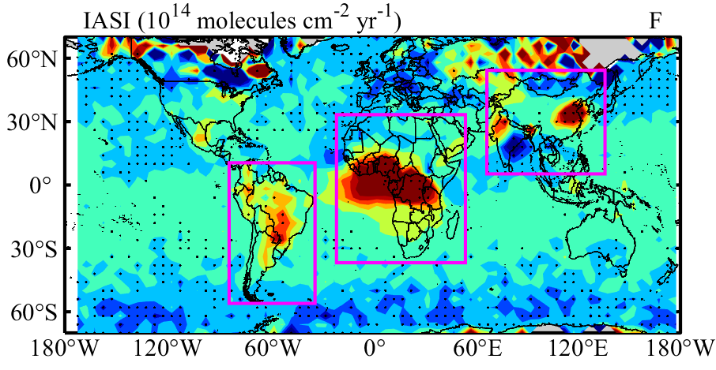
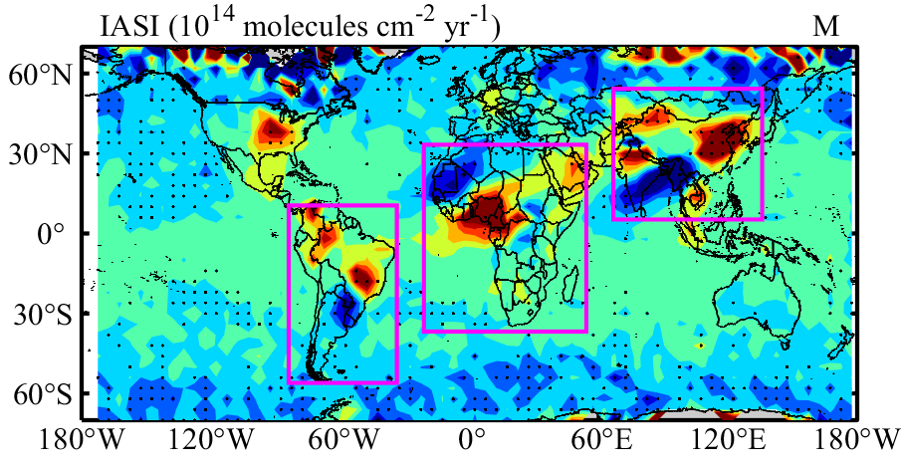
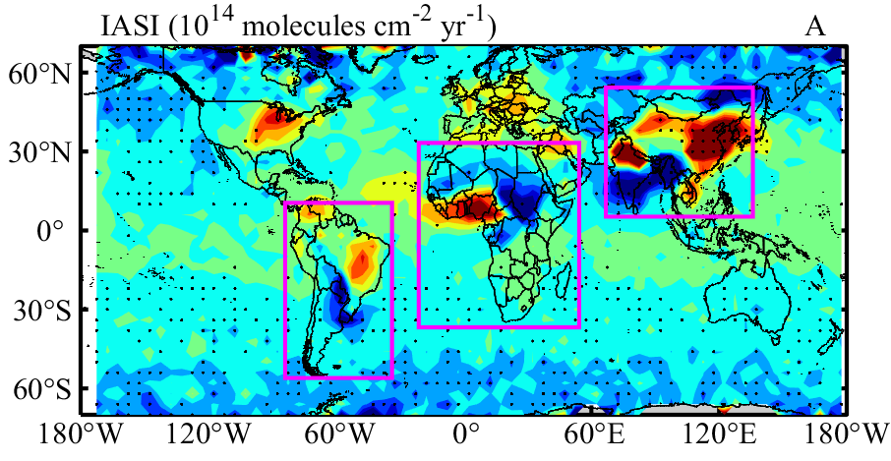
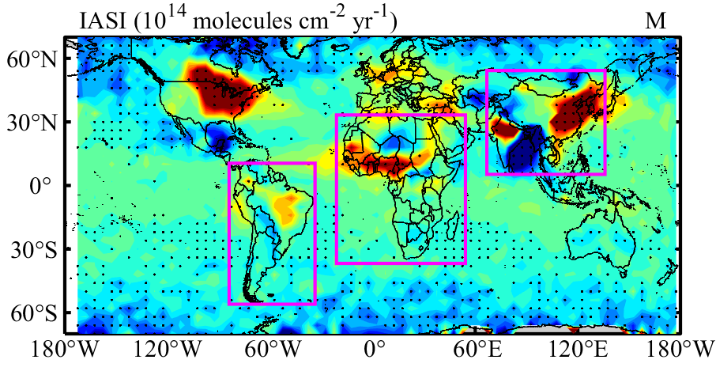
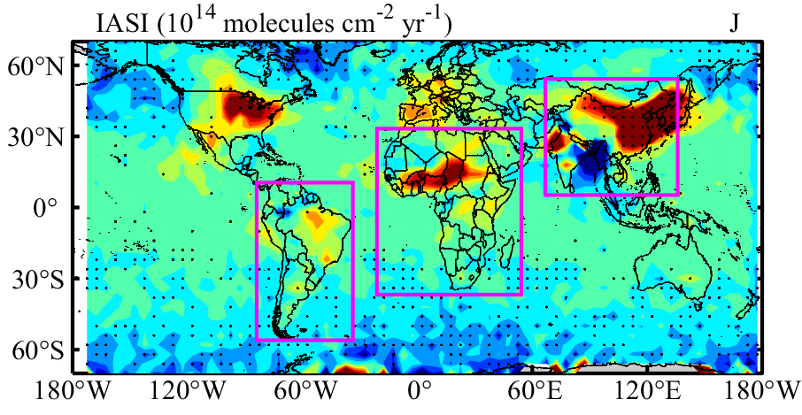
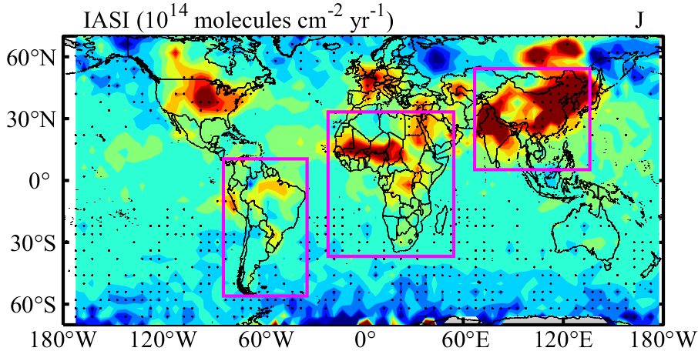
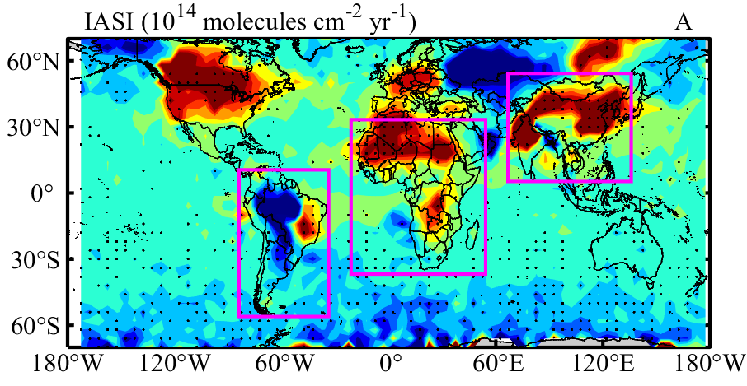
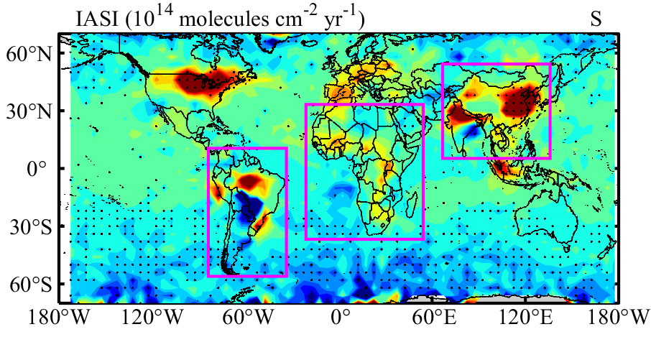
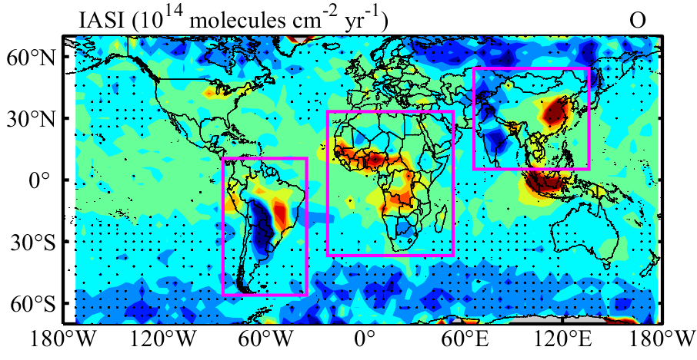
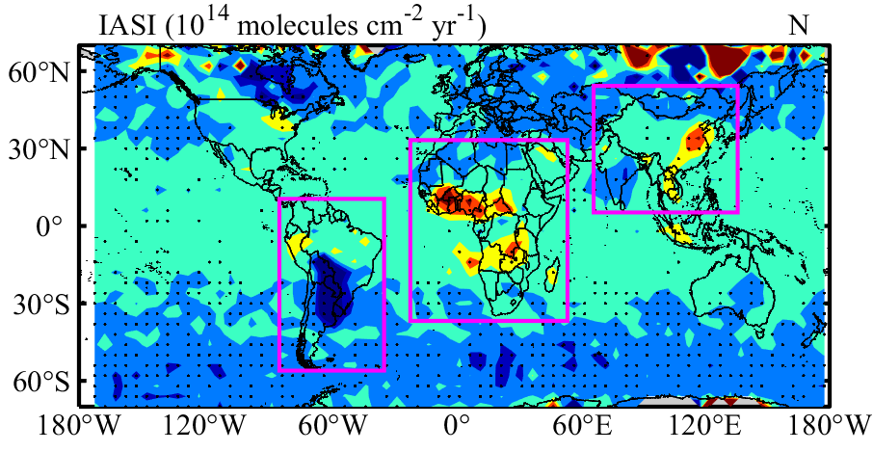
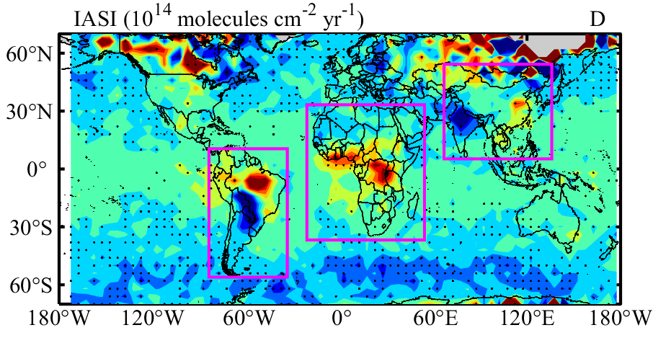
IASI trend in monthly concentration distribution

Slide 7
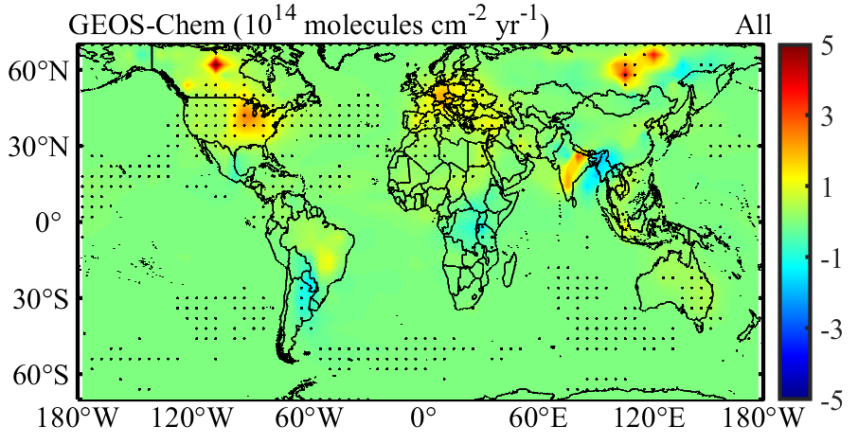
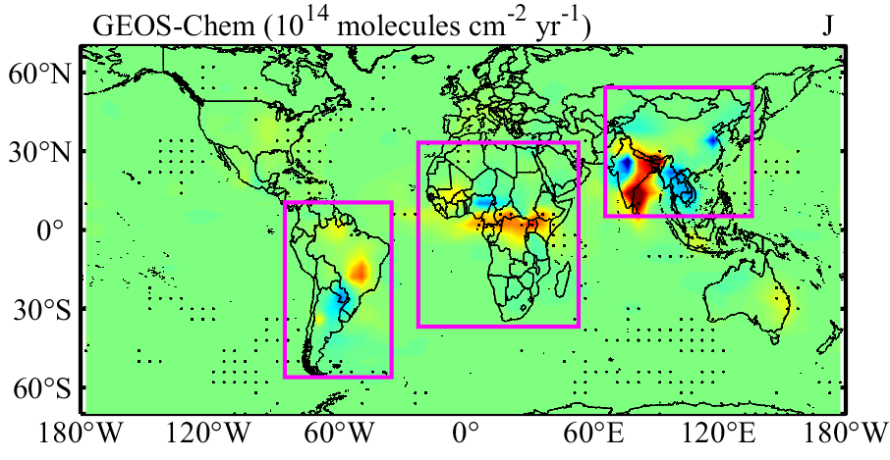
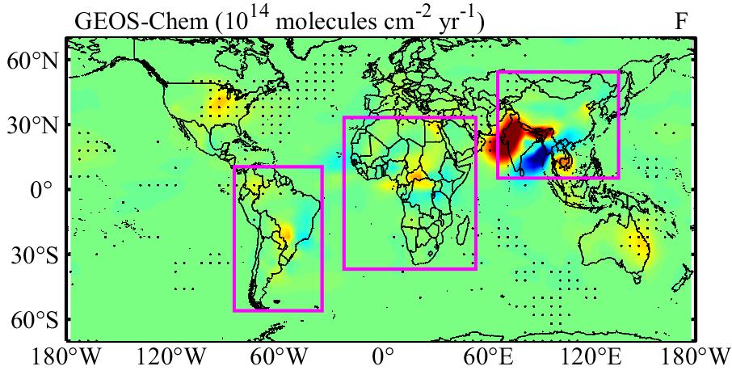
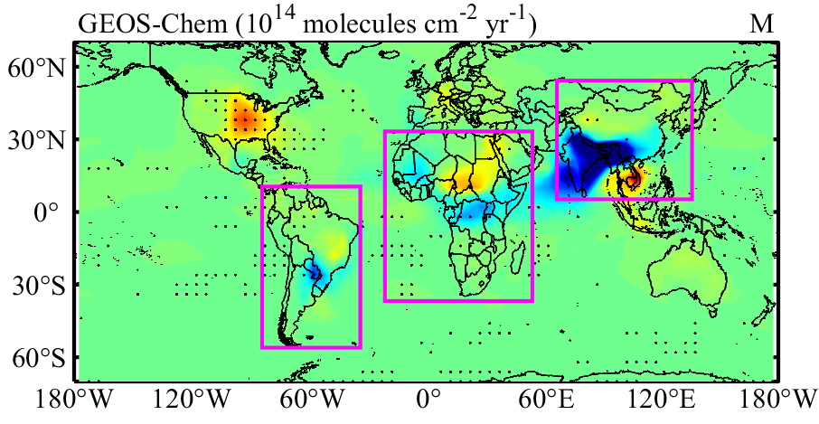
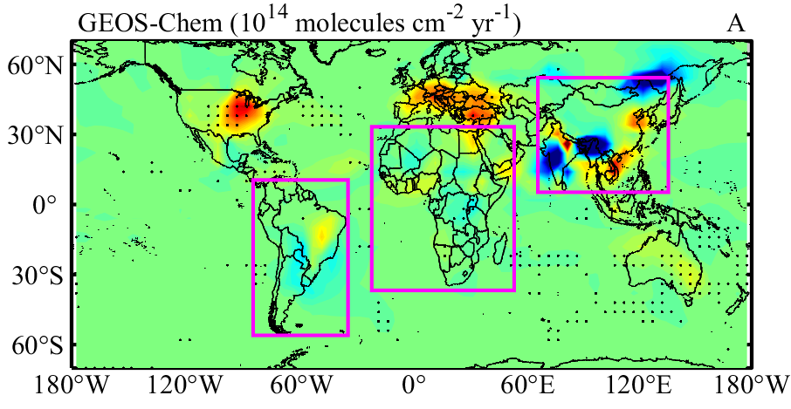
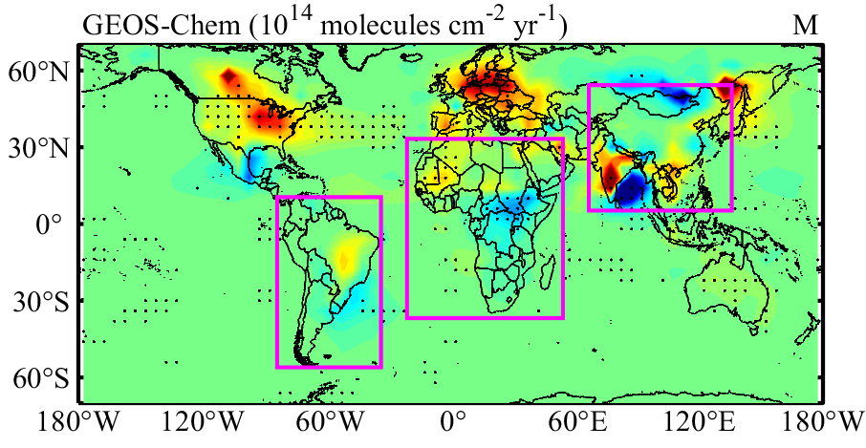
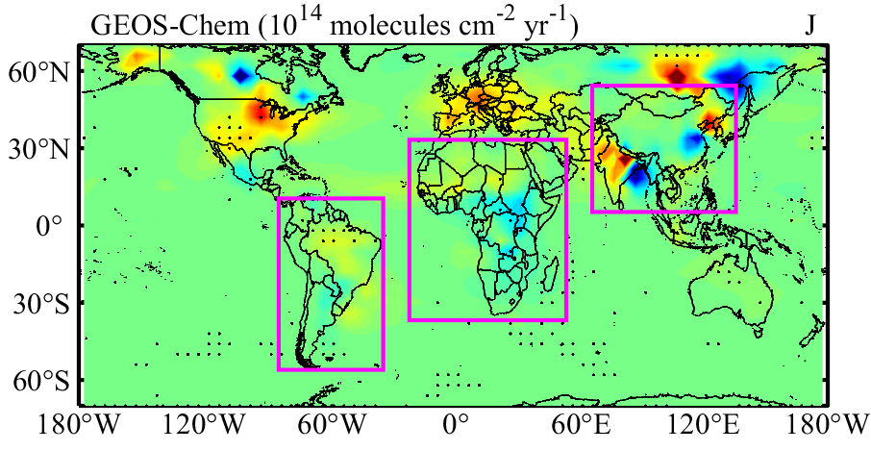
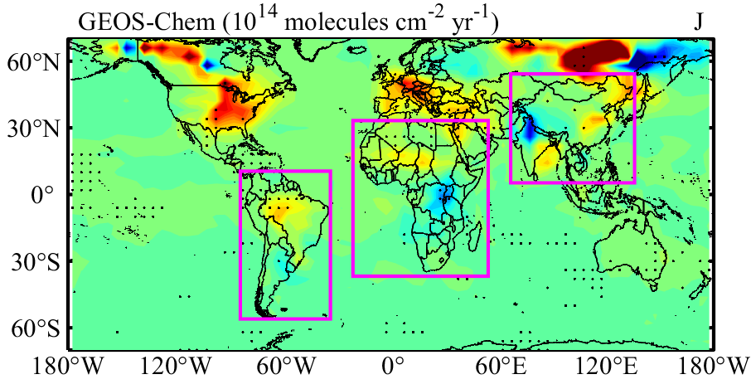
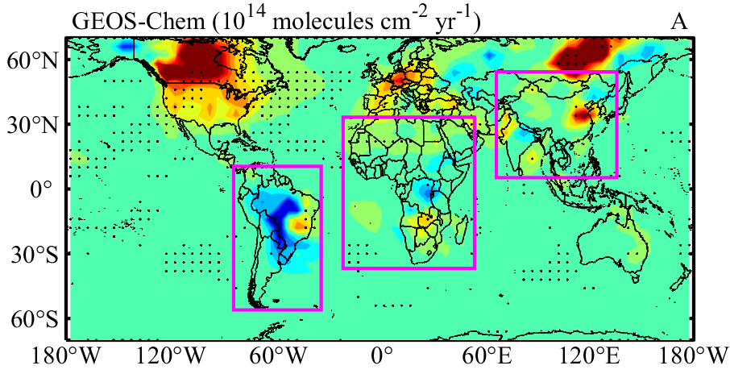
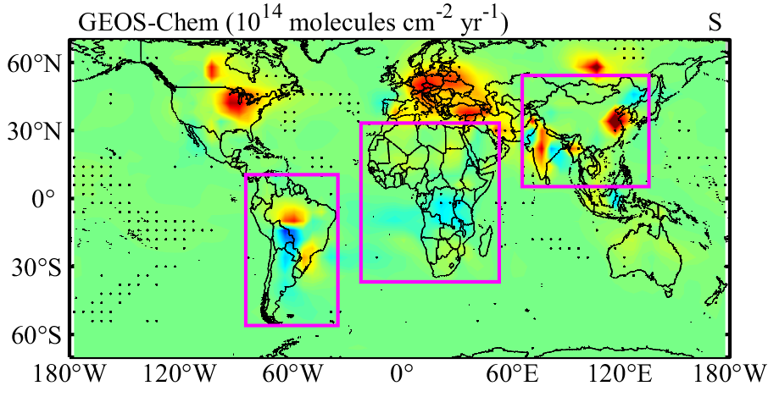
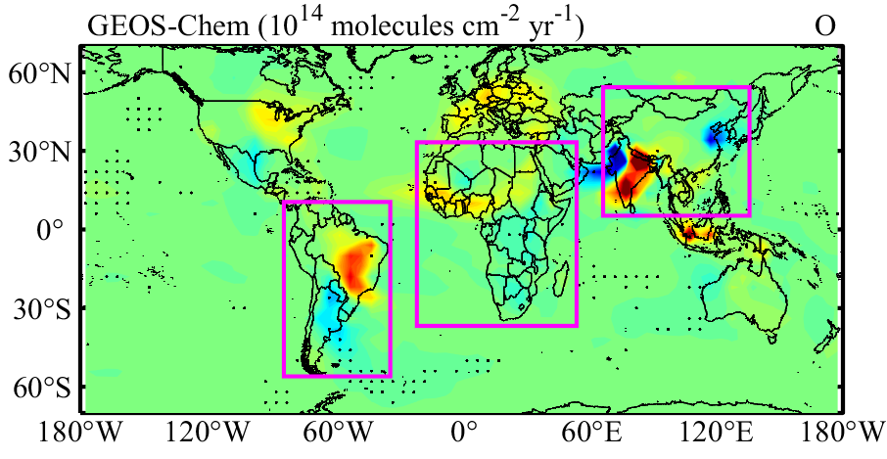
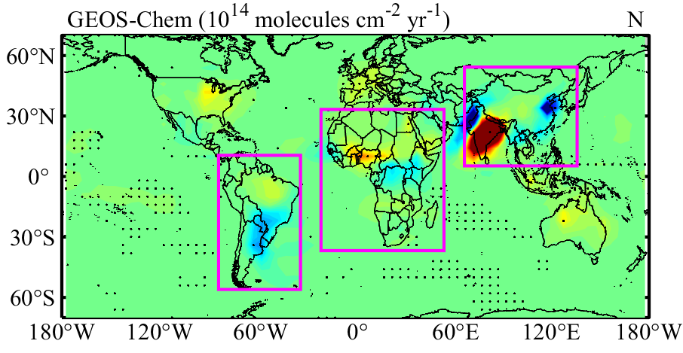
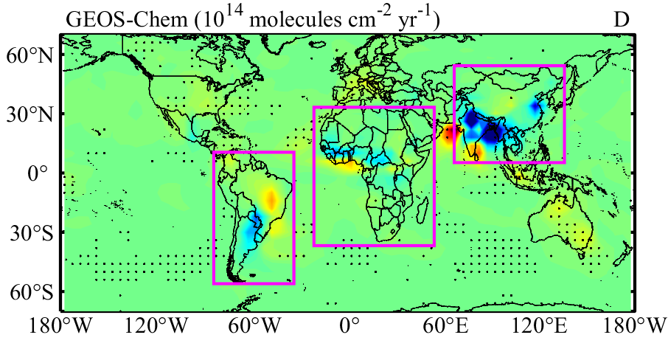
GEOS-Chem trend in monthly concentration distribution

Slide 8
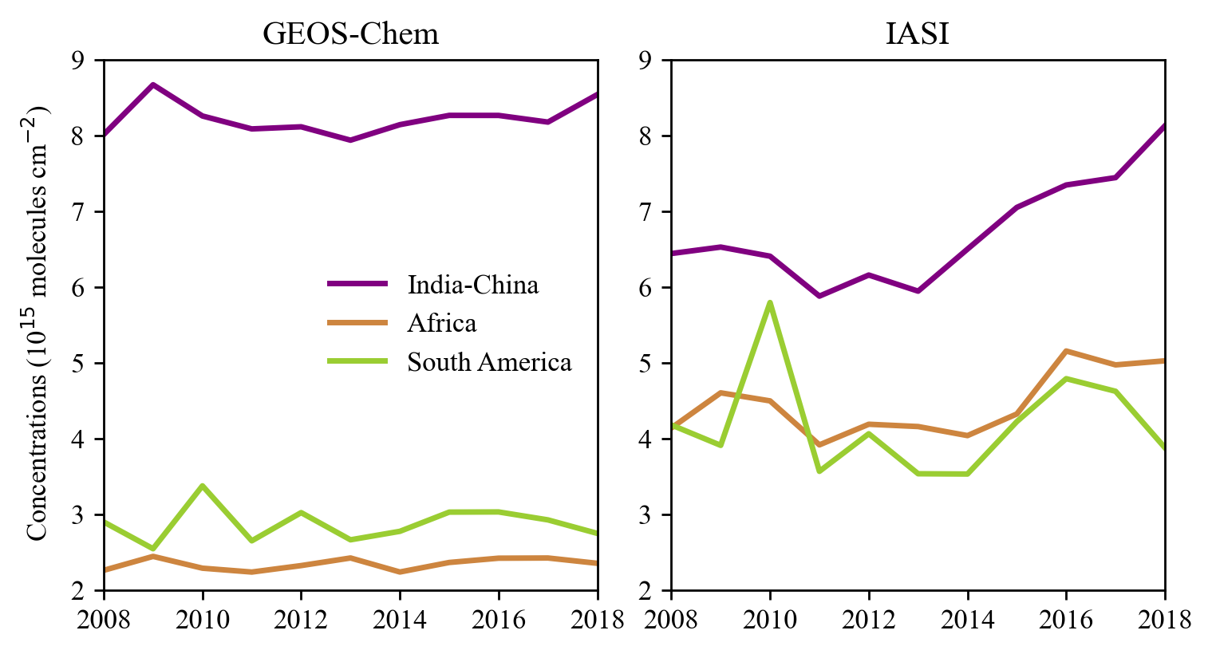

Annual and mean monthly concentration of GEO-Chem and IASI over the India-China, Africa and South America

Slide 9


IASI emission flux calculations

Slide 10






Problems encountered

Slide 11

Analysis
GEOS-Chem's lifetime is short

Slide 12
litreature

Slide 13

ammonia
implications:
Population: formation of PM2.5——premature mortality
penetrate the human respiratory systems
deposit in the lungs and alveolar regions
Environment:
semi-natural ecosystems eutrophication,
soil acidification,
particulate matter secondary formation,
the global greenhouse balance alteration
reacts with the sulfuric and nitric acids——contribute 30 % to 50 % of the total aerosol mass of PM2.5/PM10
climate impact:
affect Earth’s radiative balance
scattering incoming radiation (directly)
cloud condensation nuclei (indirectly)
visibility problems: haze effect
Sources: wild animals, ammonia-containing watersheds, traffic, sewage systems, humans, biomass burning, domestic coal combustion, volcanic eruptions, agriculture (majority)
Monitoring: EMEP (Europe), EAAD (Southeastern Asia), AMoN-US (US), NAPS (Canda)
Satellite: IASI, AIRS, CrIS, TES, GGOS (Greenhouse Gases Observing Satellite)
Increase in mortality linked to outdoor air pollution from 2010 to 2050
(Lelieveld et al., 2015, Nature)
Notes:
East Asia acid deposition NETwork

Slide 14



method
Satellite
IASI: ANNI NH3-v2.1R-I product
Morning data
Cloud fraction < 10%
CrIS: S-NPP satellite
improved vertical sensitivity
Overpass (13:30) coincides with high thermal contrast
Inverse Distance Weighting (IDW) interpolation: oversampling methods
Emission flux calculation: a 1–dimensional box model
LMDz-OR-INCA chemistry transport model: calculate ammonia lifetime/simulate ammonia concentrations
LMDz: General Circulation Model
INCA: INteraction with Chemistry and Aerosols model
ORCHIDEE: land surface dynamical vegetation model
2.5°×1.3°
39 hybrid vertical levels extending to the stratosphere
2007-2017

Slide 15




Results——2008-2017
Modelled lifetime: 11.6±0.6 hours
Satellite-constrained emissions
Average
Seasonal variability
2008-2011: decline
2012-2014: little variation
2015: increase steeply
2016-2017: high level
Sulfur dioxide column concentration anomaly after 2015
NH3 emissions anomaly after 2015
(Evangeliou et al., 2020)

Slide 16


Results——2008-2017
Comparison with emissions applying a constant lifetime of 0.5 days (Damme et al., 2018)
Latin America: higher
Tropical Africa: lower
Indo-Gangetic Plain: lowerand more northerly
Site-specific emissions and seasonal variation
European: no obvious seasonality——livestock production (75%)
Belgium,
the Netherlands
the Po Valley in Italy
US: late spring——mineral fertilizer and manure application, summer——livestock housing emissions
Central US: large agricultural
Iowa, Texas, Kansas and Idaho: swine, chickens and cattle
midwestern US: pig farms
California: vegetables, dairy, beef cattle and chickens
South America: fires and volcanoes——largest fluxes observed from August to October
Southeastern Asia: peak in late summer——largest agricultural contributor
(Evangeliou et al., 2020)

Slide 17


validation——the Gaussian kernel density estimation (KDE)
Ground-based observations: EMEP
EGG: ECLIPSEv5-GFED4-GEIA
NE: from IASI——model's lifetime
VD0.5: from Van Damme et al. (2018)——12 hours lifetime
VDgrlf: from Van Damme et al. (2018)——model's lifetime
Satellite: CrIS
(Evangeliou et al., 2020)

Slide 18
plan
Regional detail
IASI emission
Notes:
:long_name = "The averaging kernel is the sensitivity of the estimated state to variations in the atmospheric state.
The averaging kernel matrix is stored in [col,row] notation. The rows of the averaging kernel represent the sensitivity of the estimated state at a specific pressure level to variations in the atmospheric state at all levels.
The columns of averaging kernel represent the sensitivity of the estimated state at all levels to variations in the atmospheric state at specific pressure level.
For atmospheric species this is the sensitivity of retrieved ln(vmr) to the true ln(vmr).";

Slide 19
Questions?

